Slide 1

Technology Trends in Software Development: Current Usage and Future Desires
Chad Saglam
07.01.2025

Slide 2

OUTLINE
Executive Summary
Introduction
Methodology
Results
Visualization – Charts
Dashboard
Discussion
Findings & Implications
Conclusion
Appendix

Slide 3

EXECUTIVE SUMMARY
This report analyses current and future trends in technology skills demand, focusing on programming languages, databases, platforms, and web frameworks. Key findings include:
Top Programming Languages:
Current: JavaScript, HTML/CSS, SQL, Bash/Shell, Python.
Future: JavaScript remains dominant, with Python and TypeScript gaining popularity.
Top Databases:
Current: MySQL, Microsoft SQL Server, PostgreSQL.
Future: PostgreSQL and MongoDB are most desired.
Popular Platforms:
Current: Windows, Linux, Docker, AWS.
Future: Docker, AWS, and Android are highly desired.
Web Frameworks:
Current: jQuery, React.js, Angular.
Future: React.js and Vue.js lead demand.
Demographics:
Majority of respondents are males aged 28, from the USA, with Bachelor’s or Master’s degrees.
Implications:
Developers should focus on JavaScript, Python, PostgreSQL, and React.js.
Organizations should invest in Docker, AWS, and emerging technologies like TypeScript and Go.
Data was sourced from Stack Overflow, IBM, and GitHub, analyzed, and visualized to provide actionable insights.

Slide 4

INTRODUCTION
Objective: Analyse current and future trends in software development to identify in-demand skills and technologies.
Scope: Focus on programming languages, databases, platforms, and web frameworks shaping the industry.
Data Source: Insights from Stack Overflow’s 2019 Developer Survey, with nearly 90,000 developers sharing their preferences and experiences.
Importance: Understanding these trends helps organizations and developers align with industry demands and stay competitive in a rapidly evolving tech landscape.
Key Questions:
Which programming languages are most in demand today, and which will dominate tomorrow?
What databases and platforms are most sought after now, and what will be in demand in the future?
What web frameworks are developers embracing?
Target Audience: IT professionals, HR managers, and tech enthusiasts seeking to understand the skills driving the future of technology.

Slide 5

METHODOLOGY
Data Collection:
Survey data was collected globally from developers, focusing on technologies they currently use and desire to use in the future.
Additional data was gathered from multiple sources:
Github Jobs API: Extracted data on the number of jobs available for different technologies and locations using Python.
IBM Website: Scraped programming language names and their yearly wages.
Stack Overflow Developer Survey (2019): Downloaded and saved the dataset, which involved 88,883 software developers from 179 countries.
Data Analysis:
Data was cleaned and analysed using Python.
Exploratory Data Analysis (EDA): Conducted to assess data distribution, identify outliers, and analyze correlations between columns.
Aggregated and visualized data using bar charts to identify top technologies in each category.
Tools Used:
IBM Cognos Analytics: For advanced data visualization and analysis.
Python: For data collection, cleaning, and exploratory analysis.
Limitations:
Data is self-reported and may not represent all regions or industries equally.
Familiarization with the dataset and tools was achieved through IBM labs on Coursera, covering topics like Web Scraping, Data Wrangling, EDA, and Data Visualization.

Slide 6
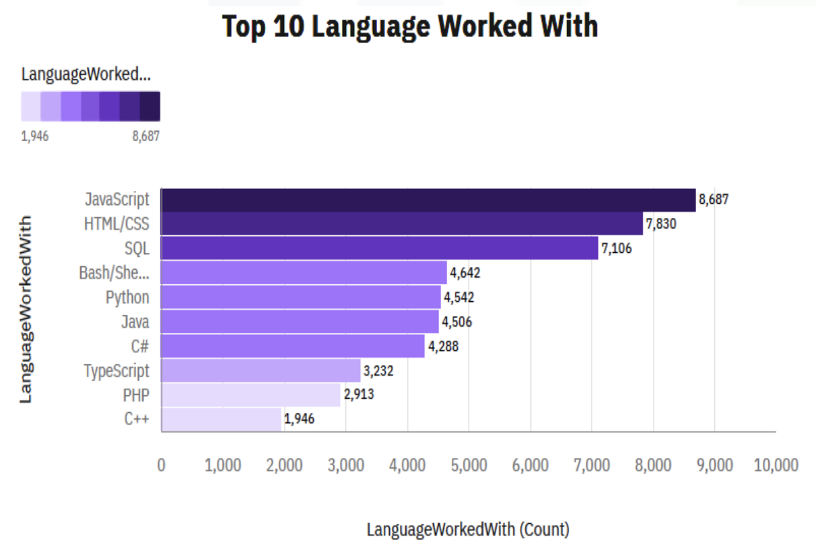
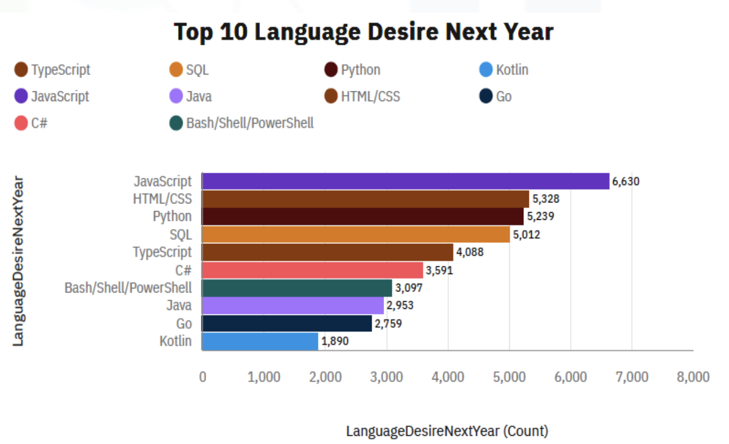
PROGRAMMING LANGUAGE TRENDS
Current Year
Next Year

Slide 7
PROGRAMMING LANGUAGE TRENDS - FINDINGS & IMPLICATIONS
Findings:
Current Usage:
JavaScript, HTML/CSS, SQL, Shell languages, and Python are the most used programming languages today.
JavaScript and HTML/CSS dominate as the most widely used languages, particularly in web development.
SQL maintains a strong presence, reflecting its importance in data management and querying.
Python has edged out Java in overall ranking, showcasing its growing popularity.
Future Trends:
JavaScript, HTML/CSS, Python, SQL, and TypeScript are projected to be the most used languages in the coming years.
Python is expected to surpass SQL in demand next year, driven by its versatility and applications in AI, machine learning, and data science.
TypeScript and Go are emerging as desired languages for modern development, indicating a shift toward more robust and scalable technologies.
Implications:
For Organizations:
Invest in training programs for JavaScript and Python, as these languages remain critical for web development and emerging technologies like AI/ML.
Encourage adoption of TypeScript and Go to stay competitive in modern software development.
For Developers:
Master JavaScript and HTML/CSS to remain relevant in web development, especially with the growing popularity of TypeScript.
Learn Python to capitalize on its increasing demand across domains like AI, data science, and software development.
Develop SQL skills, as it remains essential for data professionals, including data analysts, scientists, and business analysts.
For Future Projects:
Prioritize Python for its versatility and ease of use in diverse applications.
Consider adopting TypeScript for scalable and maintainable web development projects.

Slide 8
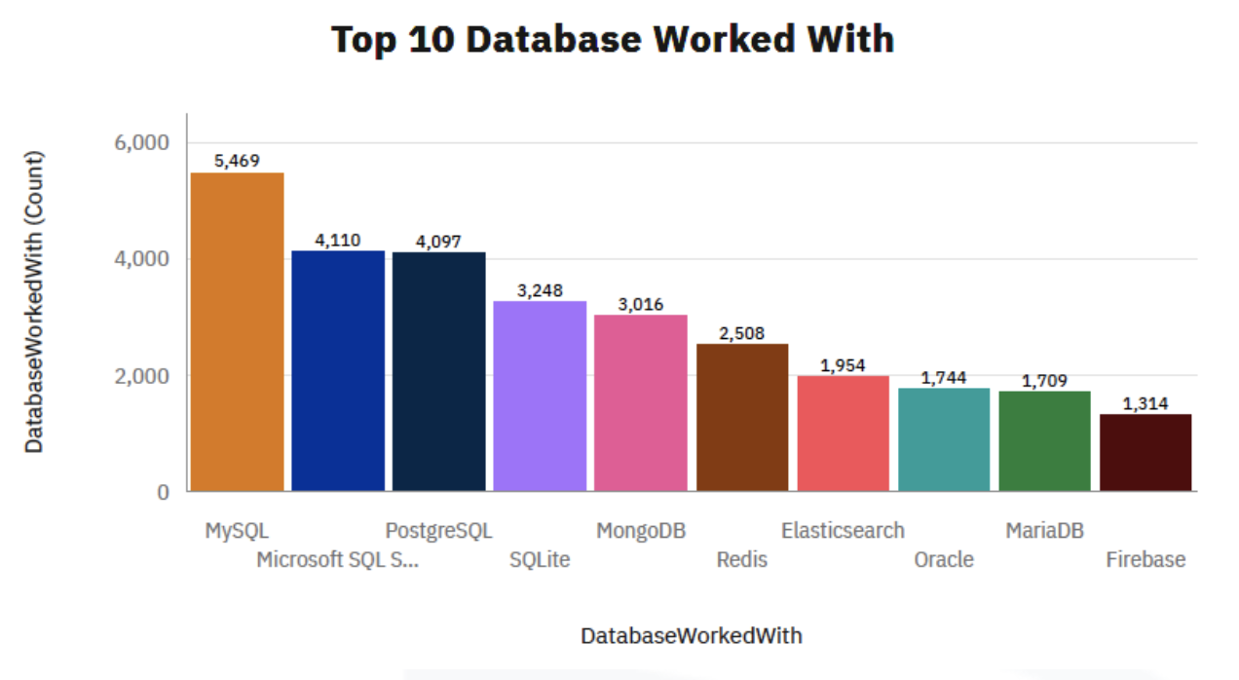
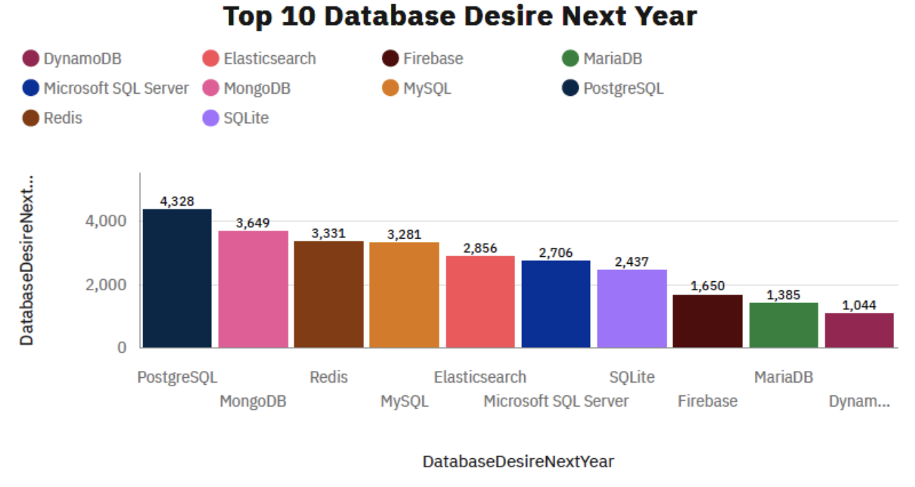
DATABASE TRENDS
Current Year
Next Year

Slide 9
DATABASE TRENDS - FINDINGS & IMPLICATIONS
Findings:
Current Usage:
MySQL leads as the most widely used database management system (DBMS), followed closely by PostgreSQL and Microsoft SQL Server.
MongoDB ranks as the top NoSQL database, reflecting the growing adoption of NoSQL solutions.
The top 5 most used databases at the moment are MySQL, Microsoft SQL Server, PostgreSQL, SQLite, and MongoDB.
Future Trends:
PostgreSQL and MongoDB are the most desired databases for the next year, indicating a shift in preference.
Emerging tools like Redis and Elasticsearch are gaining traction and are projected to become more popular in the IT space.
MySQL, while still widely used, is less desired compared to PostgreSQL, suggesting a potential decline in its dominance.
Oracle SQL is losing relevance and did not rank among the top 5 databases
Implications:
For Organizations:
Consider adopting PostgreSQL for its growing popularity and robust features.
Explore NoSQL databases like MongoDB and Redis for applications requiring flexible data models and scalability.
Prioritize open-source databases, as they remain highly preferred by companies.
For Developers:
Focus on learning PostgreSQL and NoSQL databases like MongoDB and Redis to stay competitive.
Maintain SQL skills, as relational databases remain critical for data specialists, including data analysts and scientists.
Keep an eye on emerging tools like Redis and Elasticsearch, which are set to gain more traction in the IT space.
For Future Projects:
Evaluate the use of PostgreSQL for its balance of performance, scalability, and open-source benefits.
Leverage NoSQL databases like MongoDB for modern web and mobile applications requiring flexible data structures.
Monitor the declining relevance of Oracle SQL and consider transitioning to more modern and cost-effective solutions.

Slide 10

DASHBOARD
Link:
https://github.com/ChadSaglam/Coursera/blob/main/IBM/IBM%20Data%20Analyst%20Professional%20Certificate/IBM%20Data%20Analyst%20Capstone%20Project/Dashboards_on_Cognos.pdf

Slide 11
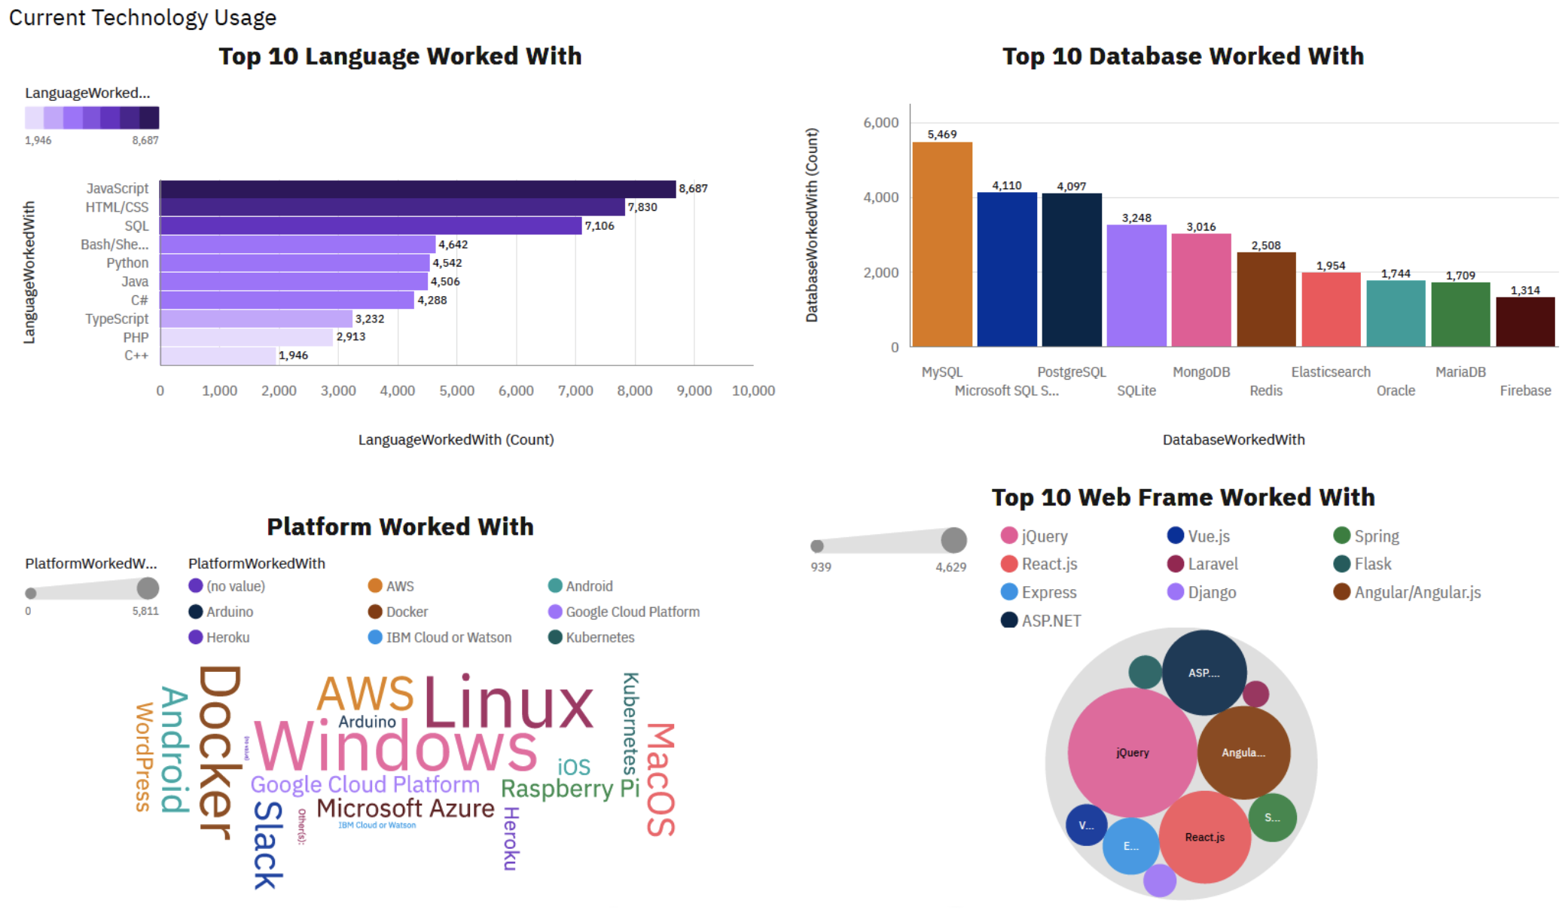
DASHBOARD TAB 1

Slide 12
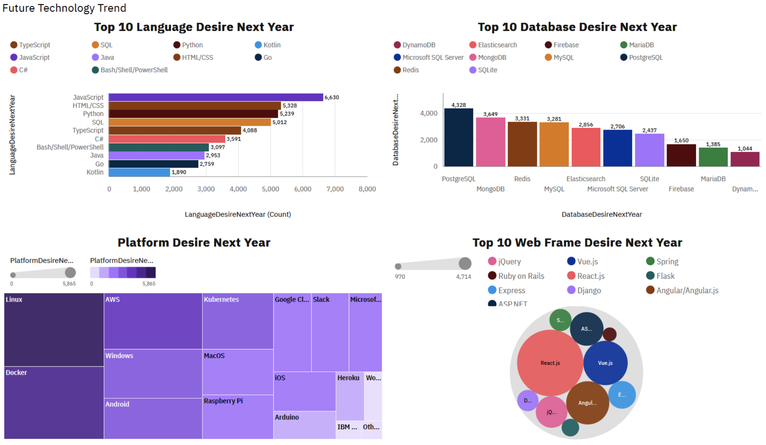
DASHBOARD TAB 2

Slide 13
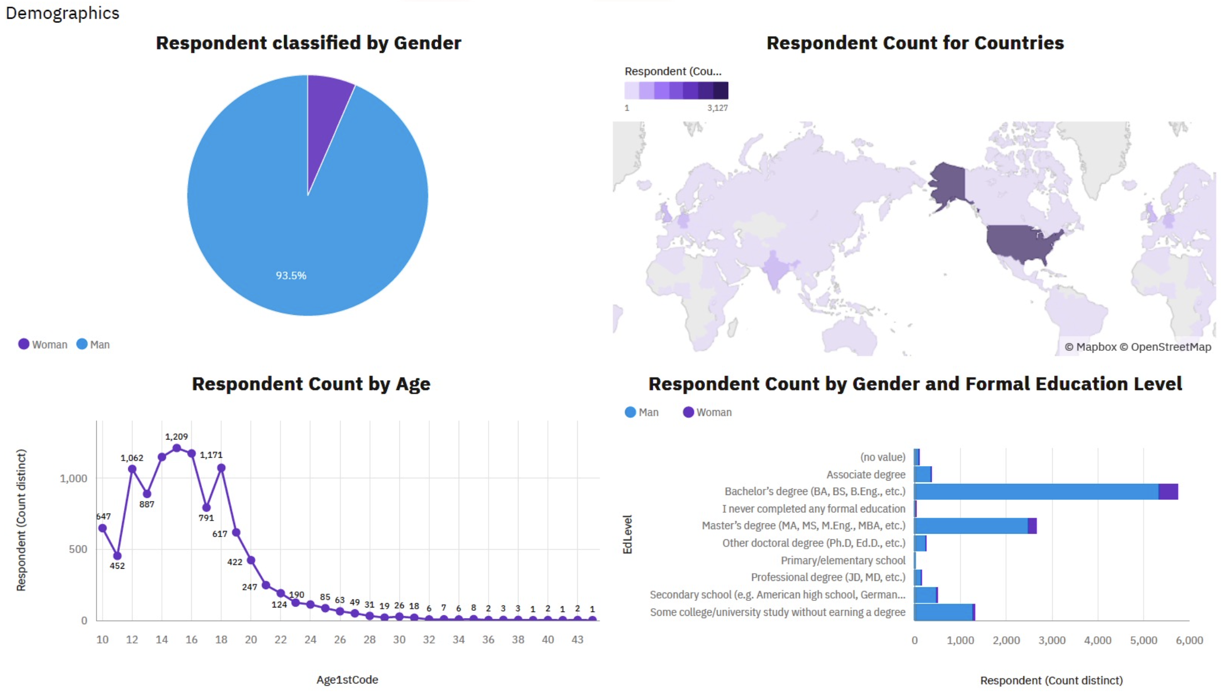
DASHBOARD TAB 3

Slide 14
DISCUSSION
Upskilling: Continuous learning in JavaScript, Python, and cloud platforms is essential.
Gender Gap: Initiatives are needed to close the gender gap in tech and promote diversity.
Advanced Degrees: The necessity of advanced degrees in tech is debatable; practical skills are equally valuable.
Mobile Development: The rise of Kotlin highlights growing demand for mobile development skills.
Global Tech Access: Expanding tech education in underdeveloped regions is critical for global innovation.
Oracle SQL: Its relevance is declining as open-source databases like PostgreSQL gain traction.

Slide 15
OVERALL FINDINGS & IMPLICATIONS
Findings:
Technology Trends:
JavaScript and Python dominate current and future developer preferences.
PostgreSQL and MongoDB are the most desired databases, reflecting a shift toward open-source and NoSQL solutions.
Docker and AWS lead in platform usage, highlighting the importance of cloud and containerization tools.
Web Development Dominance:
JavaScript and HTML/CSS remain the most popular tools, emphasizing the centrality of web development in the IT field.
React JS is a top desired skill for the future.
Data Management:
MySQL, PostgreSQL, and Microsoft SQL Server are widely used, underscoring the importance of effective data management.
The rise of NoSQL databases like MongoDB highlights the need for flexible data storage solutions.
Demographics and Education:
Most IT professionals hold a Bachelor’s degree, and the sector is predominantly composed of individuals under 40.
There is a growing need for tech education and training in less developed regions.
Implications:
For Developers:
Focus on mastering JavaScript, Python, and PostgreSQL.
Learn NoSQL databases like MongoDB and React JS to stay competitive.
For Organizations:
Invest in cloud platforms like AWS and containerization tools like Docker.
Prioritize training programs to bridge skill gaps and promote diversity.
Global Impact:
Expand access to tech education in underdeveloped regions to foster innovation and reduce disparities.
Encourage the adoption of emerging technologies like TypeScript and Go for future growth.

Slide 16

CONCLUSION
The tech landscape is evolving rapidly, with web development, cloud platforms, and data management at the forefront.
Adaptability, continuous learning, and global inclusivity are key to thriving in the IT sector.

Slide 17
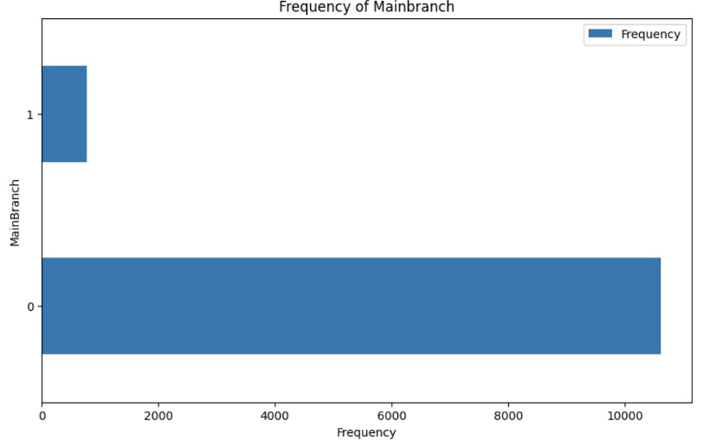

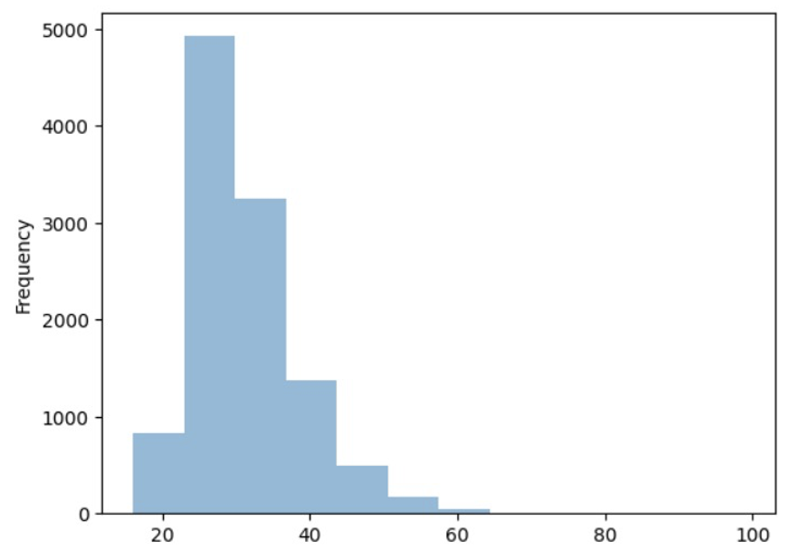
APPENDIX

Slide 18
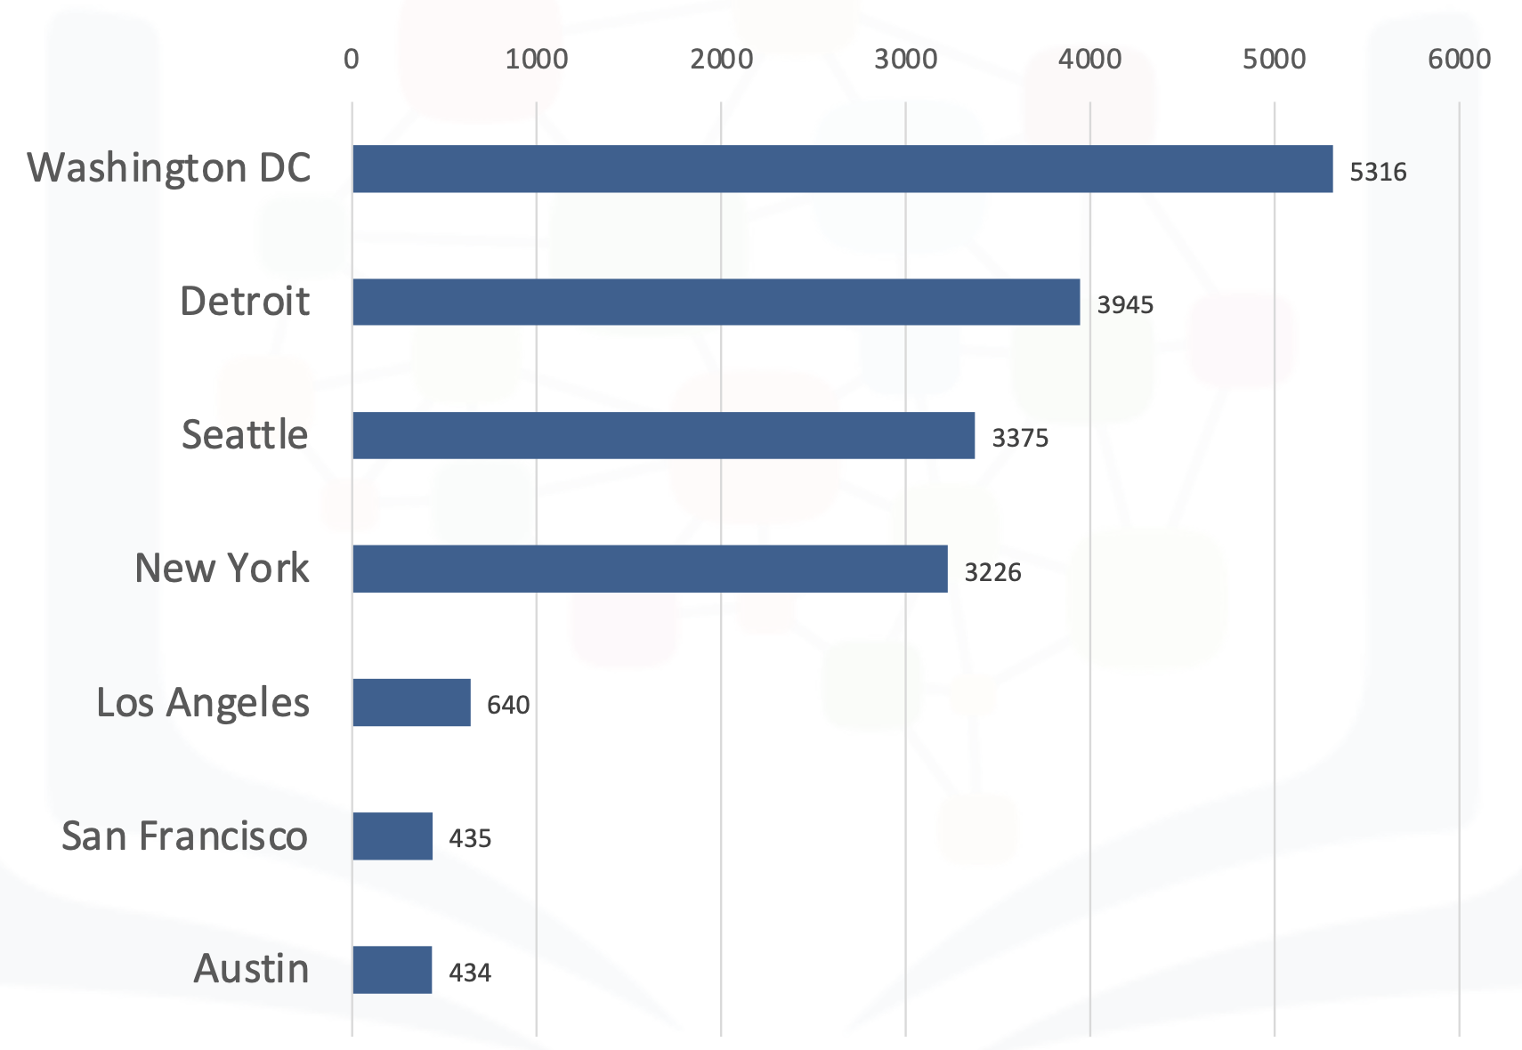
JOB POSTINGS

Slide 19
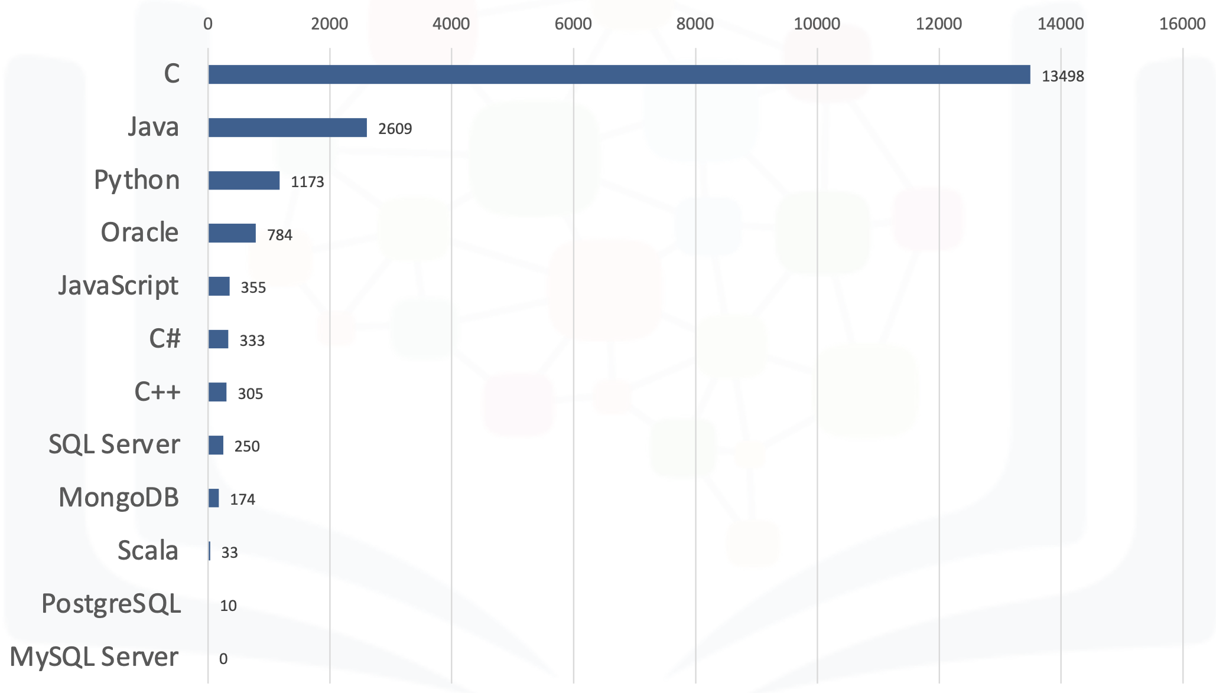
POPULAR LANGUAGES

